Slide 1
!
Credit Card Fraud Detection
using Machine Learning
Lakshay
Roll No: AP24110010677
B.Tech Computer Science and Engineering
SRM University – AP
Supervisor
Mr. Ajay Dilip Kumar Marapatla
Notes:
Machine Learning end-semester project. The project applies all five units of the syllabus to one real problem: detecting fraudulent credit card transactions.

Slide 2
The problem, in one number
99.8333%
is the accuracy of a classifier that predicts "legitimate" for every single transaction.
Frauds it detects
0 of 473
Conclusion
Accuracy cannot be used here
Every model in this project is judged on recall, precision, F1-score and PR-AUC instead.
Notes:
This single fact drives every design decision in the project. Only 0.1667% of transactions are fraudulent.

Slide 3
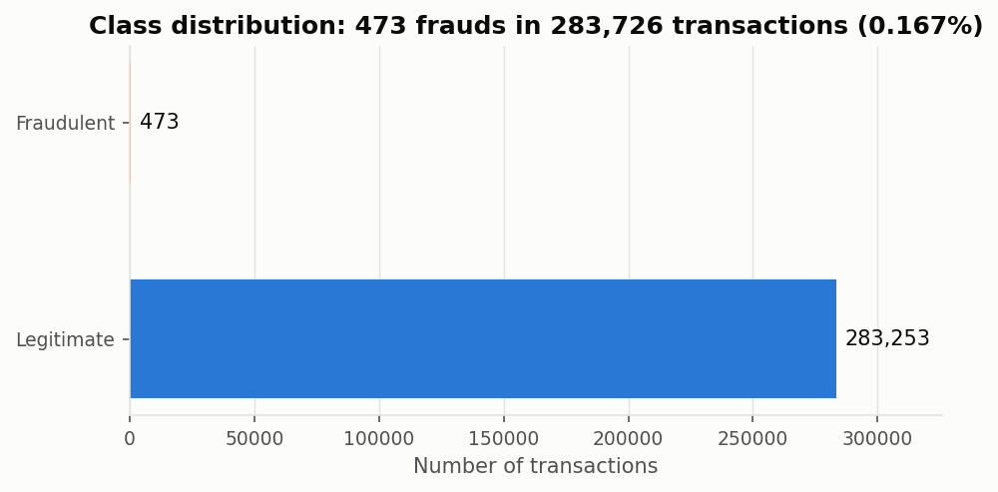
1
The dataset
Unit I
ULB / Kaggle Credit Card Fraud Detection benchmark
Property | Raw | After cleaning
Transactions | 284,807 | 283,726
Fraudulent | 492 | 473
Fraud rate | 0.1727% | 0.1667%
Duplicate rows | 1,081 | 0
Missing values | 0 | 0
Attributes | 30 + label | 30 + label
Time span | ~48 hours | ~48 hours
V1–V28 are principal components.
The publishers applied PCA to the original attributes to protect cardholder confidentiality. Only Time, Amount and Class are untransformed — so the benchmark itself is the output of a Unit II technique.
Notes:
284,807 transactions over two days in September 2013 from European cardholders. We removed 1,081 exact duplicates first — leaving them in would let the same transaction appear in both train and test.

Slide 4
2
Experimental protocol
Unit I
One split, used identically by every model
Duplicates removed BEFORE splitting — a duplicate across train and test means testing on a memorised record
One stratified 70 / 30 split, preserving the 0.1667% fraud rate in both parts
Scaling performed inside pipelines, so no test statistic ever leaks into training
Any resampling confined to cross-validation folds
5-fold stratified cross validation for model selection
Random seed
77
the last two digits of roll number AP241100106​77, as required — applied to the split, every model and every subsample
 | Transactions | Frauds | Fraud rate
Training | 198,608 | 331 | 0.1667%
Test | 85,118 | 142 | 0.1668%
Notes:
Everything is reproducible. Re-running the notebooks reproduces every number in the report exactly.

Slide 5
3
Syllabus coverage
All units
35 topics from all five units, applied to one problem
I
Types of learning · train/test/validation · cross validation · overfitting and underfitting
01, 03, 10
II
Decision tree & ID3 · k-NN · curse of dimensionality · feature selection · PCA · LDA
02, 03, 04
III
Bayesian learning · Naive Bayes · Bayes optimal decisions · SVM dual & kernels
05, 06
IV
McCulloch-Pitts · perceptron & logic gates · XOR · gradient descent · backpropagation · VC dimension
07
V
Bagging · Random Forest · boosting · fixed & trained rule fusion · K-means · hierarchical
08, 09
Notes:
Every unit is represented. The professor can point at any topic in the unitization plan and find it implemented.

Slide 6
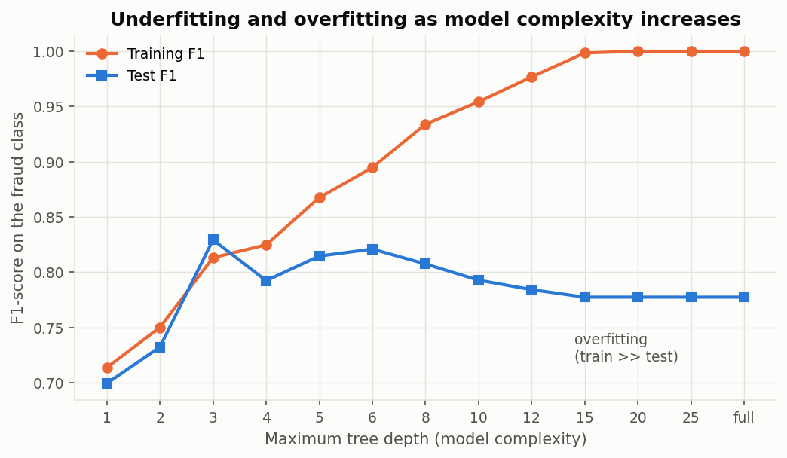
4
Overfitting and underfitting
Unit I
Demonstrated on a decision tree of increasing depth
Small depth — both curves low: the model is too simple and underfits
Large depth — training F1 climbs towards 1.0 while test F1 declines: the tree is memorising
Best test performance at moderate depth
This is why the tree used later is pruned by cross validation rather than grown without limit
Notes:
Depth is a direct measure of model complexity, so the growing gap between the two curves is overfitting made visible.

Slide 7
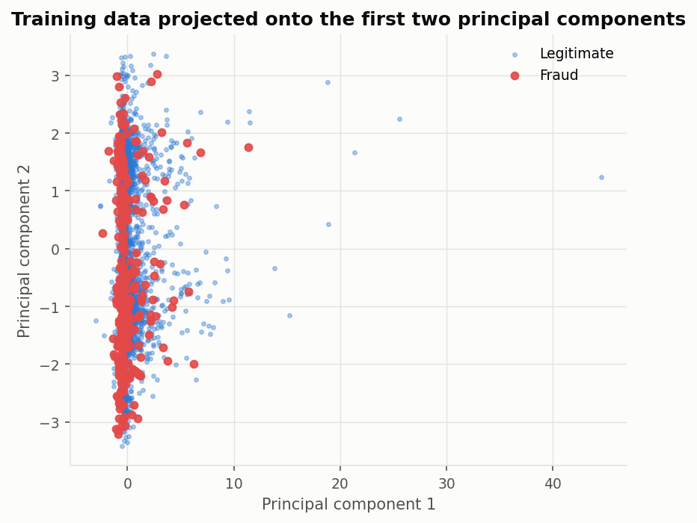
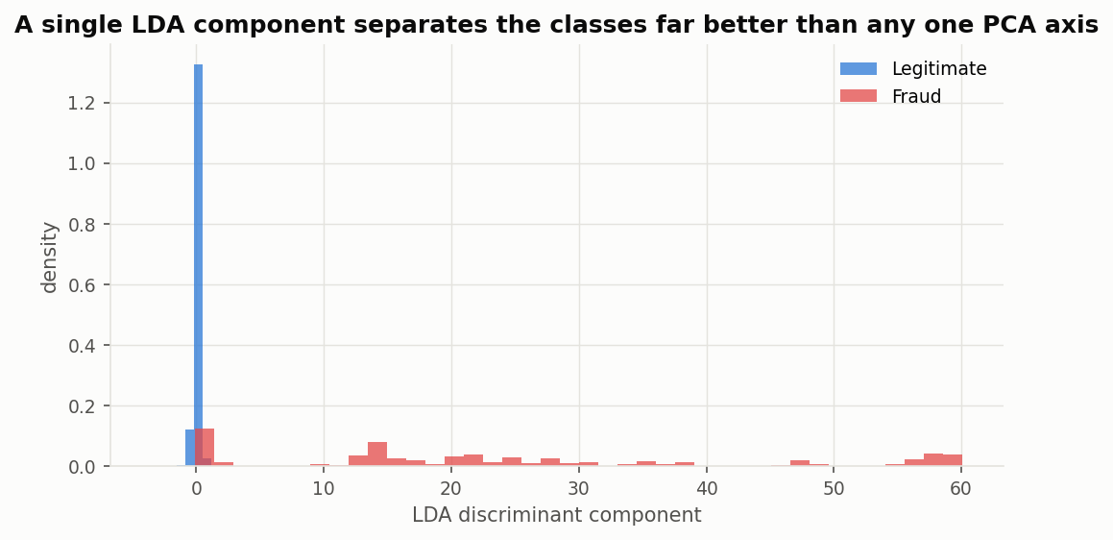
5
PCA and LDA
Unit II
Two reduction techniques with opposite objectives
PCA
Unsupervised. Maximises variance. Never looks at the class label.
LDA
Supervised. Maximises separation between class means while minimising scatter within each class.
Two PCA components leave the classes overlapped. One LDA component separates them cleanly — exactly what the two objectives predict.
Notes:
Note the dataset's own V1-V28 are already PCA output, so applying PCA again mostly reorders them.

Slide 8
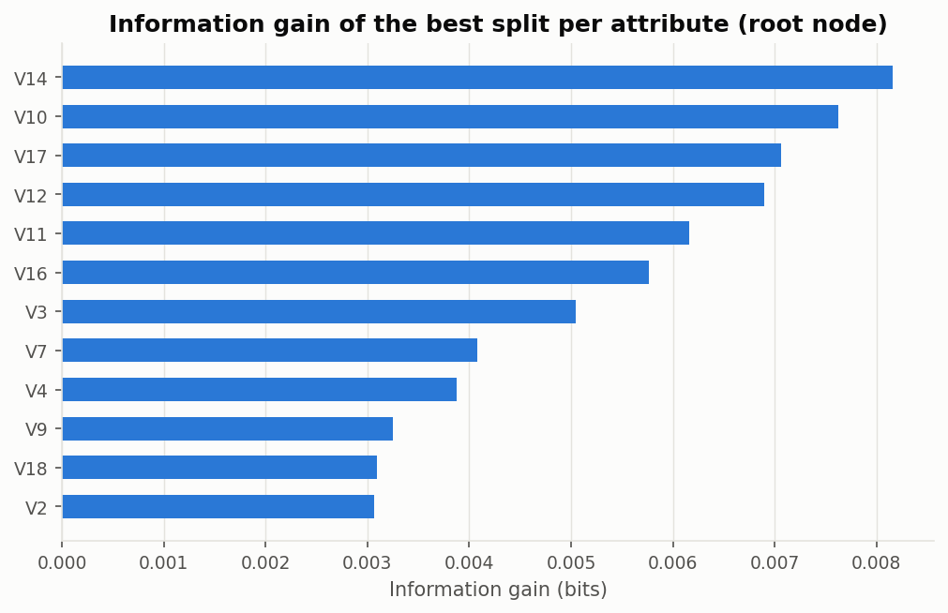
6
Decision tree learning (ID3)
Unit II
Entropy and information gain computed by hand
Entropy(S) = − Σ pᵢ log₂ pᵢ Gain(S,A) = Entropy(S) − Σ (|Sᵥ|/|S|) Entropy(Sᵥ)
Root entropy is only 0.0192 bits — the set is already almost pure, a direct consequence of the imbalance
The hand calculation reproduces the attribute the library selects
Hypothesis space is complete, so the inductive bias is a preference for shorter trees, not a restriction
Pruning depth chosen by cross validation
Notes:
ID3's bias is a preference bias — a form of Occam's razor — rather than a restriction on what it can express.

Slide 9
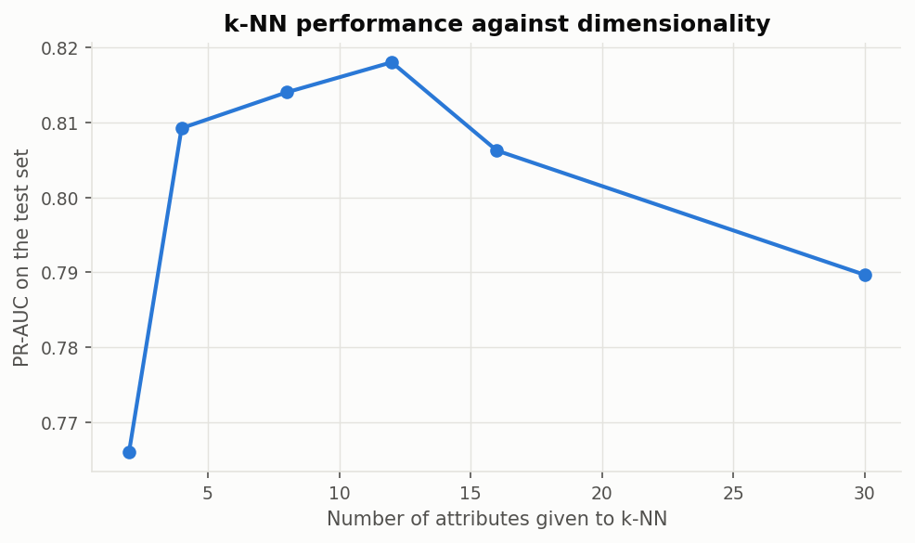
7
k-NN and the curse of dimensionality
Unit II
A prediction from theory, tested on the data
k-NN is a lazy, instance-based learner — it stores the data and approximates the target function locally
Euclidean distance worked step by step by hand, matching scikit-learn exactly
As dimensions grow, nearest and farthest neighbours become similarly distant
Measured result: performance PEAKS at a modest number of attributes, then declines — even though the extra attributes carry real information
Notes:
This is the curse of dimensionality confirmed on a real dataset, and a concrete argument for feature selection.

Slide 10
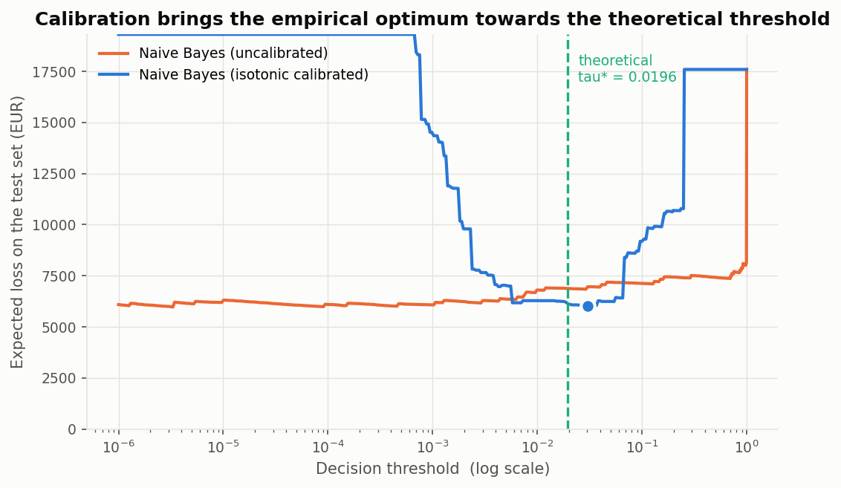
8
Bayes optimal decisions
Unit III
The optimal threshold is not 0.5
E[loss | flag] = (1−p)·C_FP E[loss | allow] = p·C_FN
Flag when the first is smaller, which rearranges to
τ* = C_FP / (C_FP + C_FN) = 1/51 ≈ 0.0196
The finding
The derived threshold did not match the empirical optimum. The cause: the derivation assumes p is a genuine probability, and Naive Bayes posteriors saturate at 0 and 1. Isotonic calibration fixed it.
Notes:
The Bayes optimal rule is correct, but it can only be applied to a model whose outputs are genuine posterior probabilities. That is a more useful conclusion than the derivation alone.

Slide 11
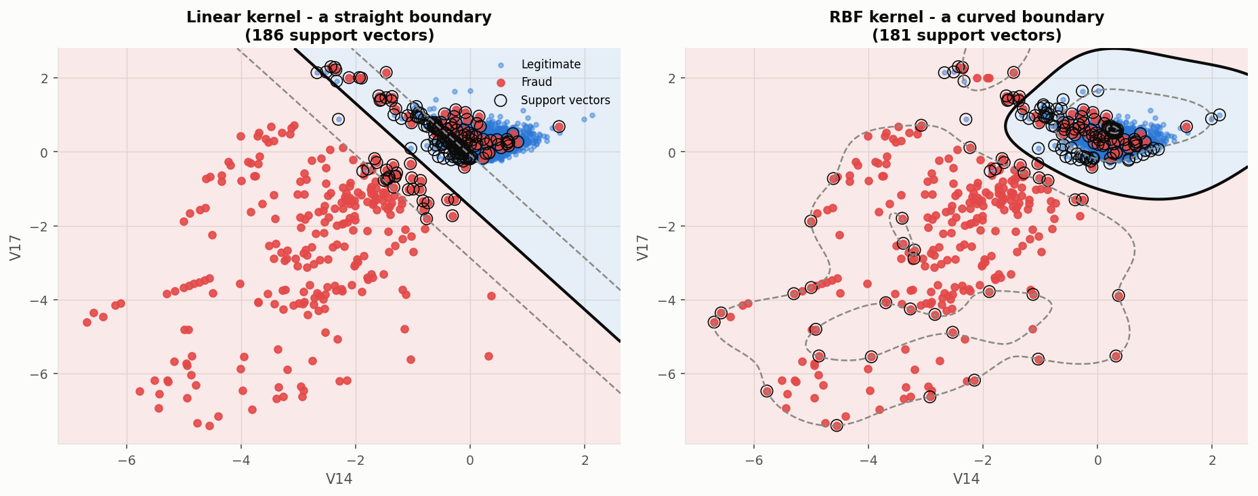
9
Support Vector Machine
Unit III
Maximum margin, the dual formulation, and kernels
The dual expresses the problem purely in terms of inner products between training points
That is what makes the kernel trick possible — a nonlinear boundary without computing the mapping
Soft margin parameter C trades margin width against training errors
RBF outperformed linear and polynomial kernels
Only the support vectors determine the boundary — the solution is sparse
Notes:
The circled points are the support vectors. Every other training point could be deleted without changing the boundary.

Slide 12
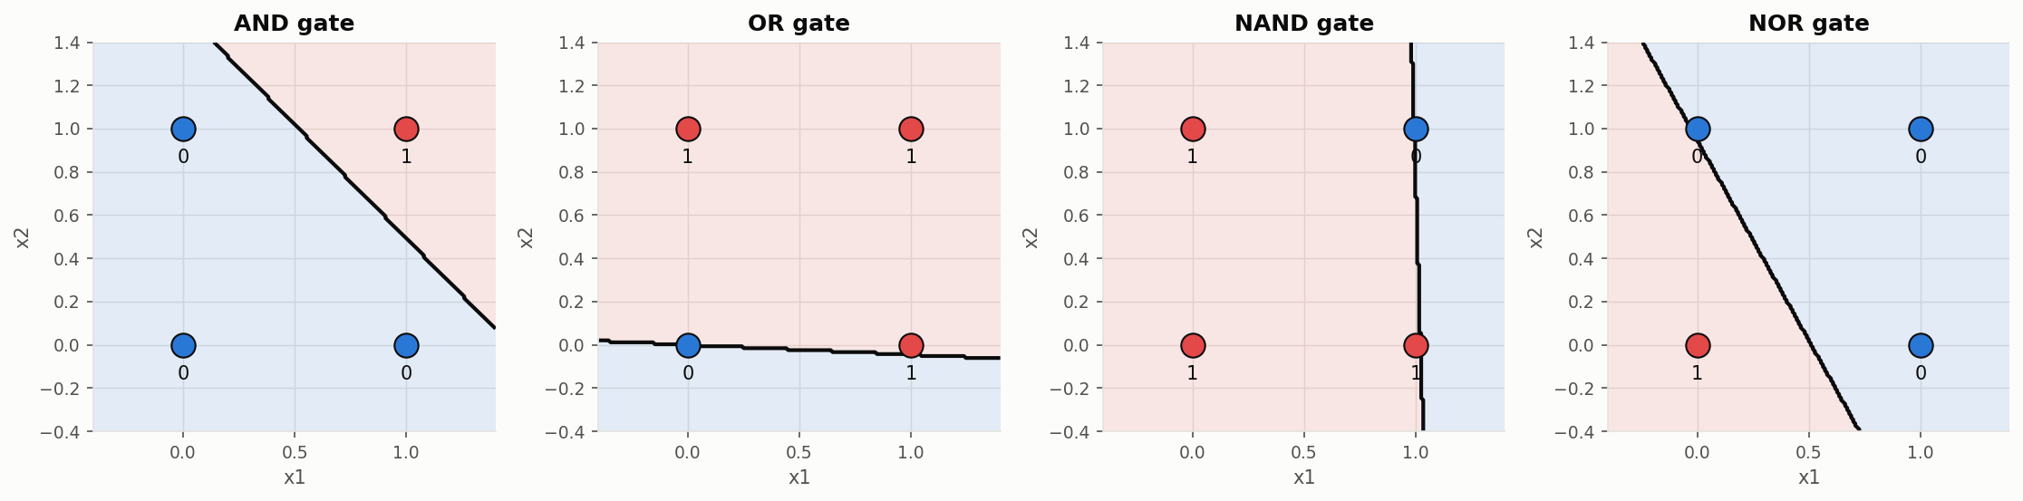
10
Perceptron — and the XOR problem
Unit IV
A theoretical result confirmed experimentally
Learns AND, OR, NAND, NOR in a few epochs — each is linearly separable
Then it fails on XOR. The error count never reaches zero, because no single hyperplane can separate the classes. A hidden layer trained by backpropagation solves it — which is exactly the history of the field.
Notes:
This is the Minsky and Papert limitation from 1969 that halted neural network research for over a decade.

Slide 13
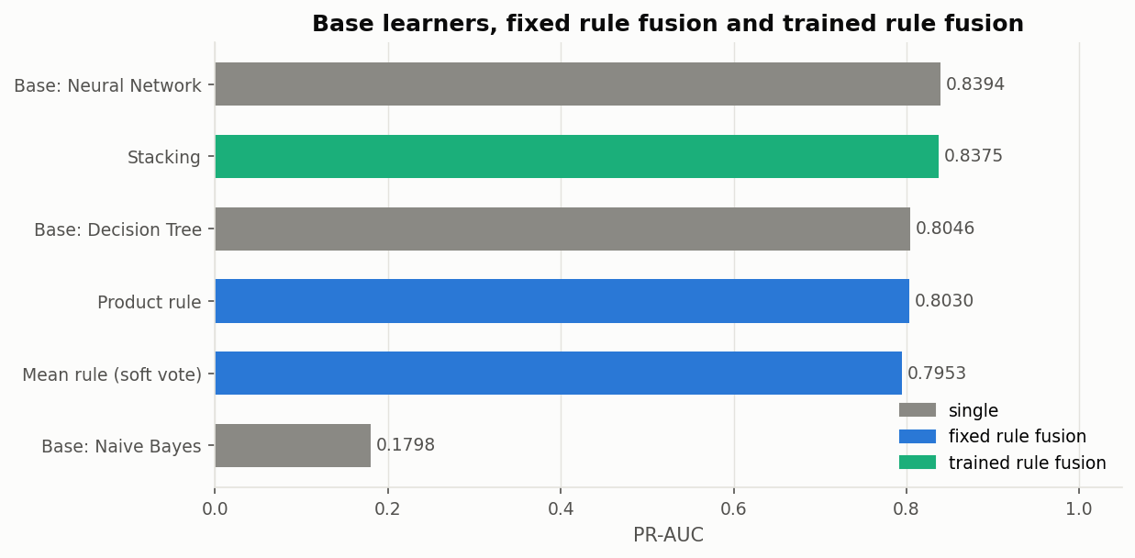
11
Ensembles and rule fusion
Unit V
Bagging, boosting, and combining different model types
Family | How | Attacks
Bagging | Parallel, on bootstrap samples | Variance
Random Forest | Bagging + attribute subsampling | Variance
Boosting | Sequential, each fixes the last | Bias
Fixed rule fusion | Majority / mean / product / max / min | —
Trained rule fusion | Stacking with a meta-learner | —
Fixed rule fusion beat trained rule fusion (0.809 vs 0.760) — with only 331 fraud examples, the stacking meta-learner has too little signal to justify its extra flexibility.
Notes:
Boosting beat bagging here, consistent with the bias-variance analysis: the decision boundary is complex, so reducing bias helps more.

Slide 14
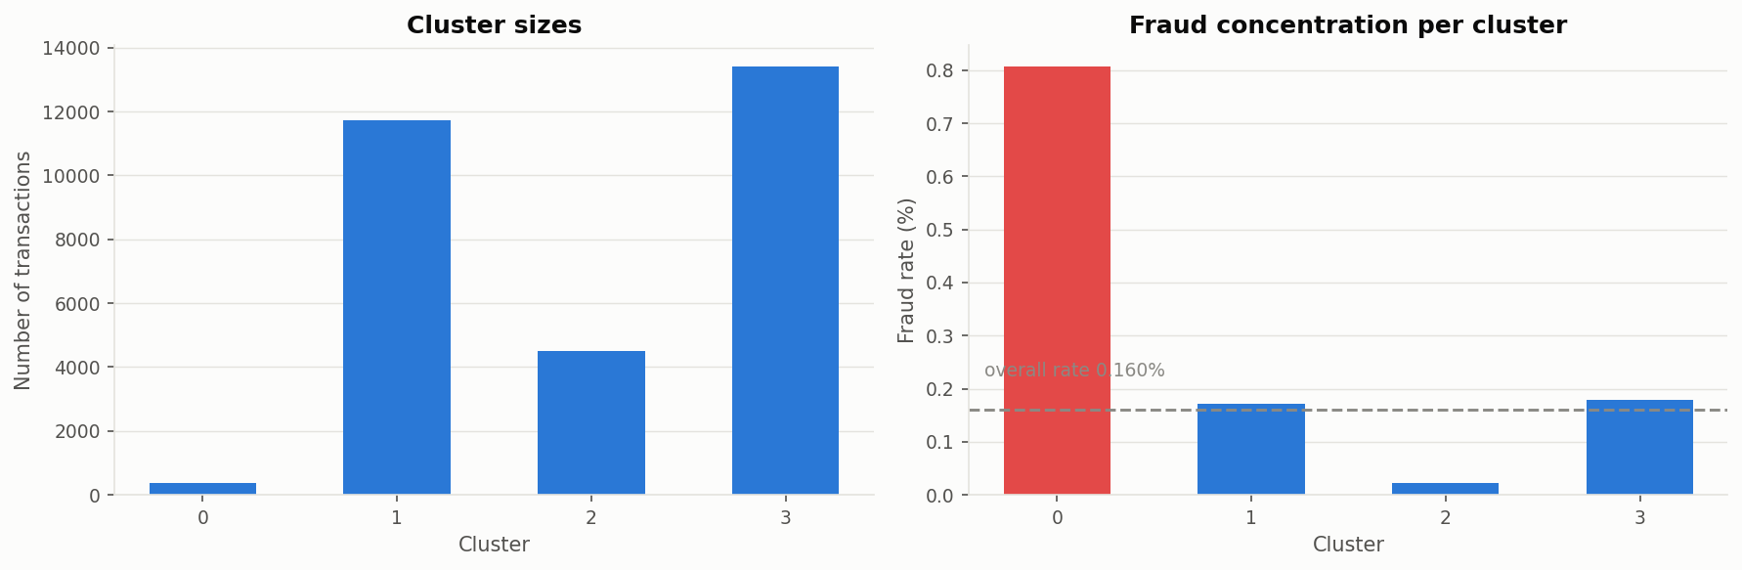
12
Clustering — learning without labels
Unit V
K-means and hierarchical clustering
The only unsupervised method in the project — labels withheld entirely during clustering
k chosen by the elbow method and silhouette score
Revealed afterwards: the clusters have strongly unequal fraud rates
K-means recovered part of the fraud structure having never seen a label
Distance to the nearest centroid works as an anomaly score
Hierarchical clustering is O(n²) in memory, so it needed a 2,000-row sample
Notes:
This matters because a clustering method could in principle flag a new kind of fraud that has never been labelled.

Slide 15
13
Results
Results
Twelve models, one test set: 85,118 transactions, 142 frauds
Model | Unit | Precision | Recall | F1 | PR-AUC
XGBoost | V | 0.9508 | 0.8169 | 0.8788 | 0.8774
AdaBoost | V | 0.9231 | 0.7606 | 0.8340 | 0.8289
Random Forest | V | 0.9717 | 0.7254 | 0.8306 | 0.8659
Decision Tree | II | 0.8672 | 0.7817 | 0.8222 | 0.8075
Neural Network (MLP) | IV | 0.9204 | 0.7324 | 0.8157 | 0.8498
Voting — fixed fusion | V | 0.8833 | 0.7465 | 0.8092 | —
k-Nearest Neighbour | II | 0.8438 | 0.7606 | 0.8000 | 0.7897
Support Vector Machine | III | 0.8333 | 0.7394 | 0.7836 | 0.7841
Stacking — trained fusion | V | 0.9474 | 0.6338 | 0.7595 | 0.8375
Perceptron | IV | 0.6761 | 0.8380 | 0.7484 | —
Naive Bayes | III | 0.1128 | 0.7746 | 0.1970 | 0.1828
K-Means (unsupervised) | V | 0.1045 | 0.6268 | 0.1791 | 0.1572
Notes:
All twelve evaluated on the identical test set from the same stratified split.

Slide 16
Look at what accuracy says
Model | Accuracy | Recall | Frauds caught
"Always legitimate" | 99.8333% | 0.0000 | 0 of 142
Stacking | 99.9295% | 0.6338 | 90 of 142
XGBoost | 99.9624% | 0.8169 | 116 of 142
0.13 percentage points
separate a model that catches nothing from the best model in the study. That is the whole argument for not using accuracy.
Notes:
This slide is the core methodological message of the project.

Slide 17
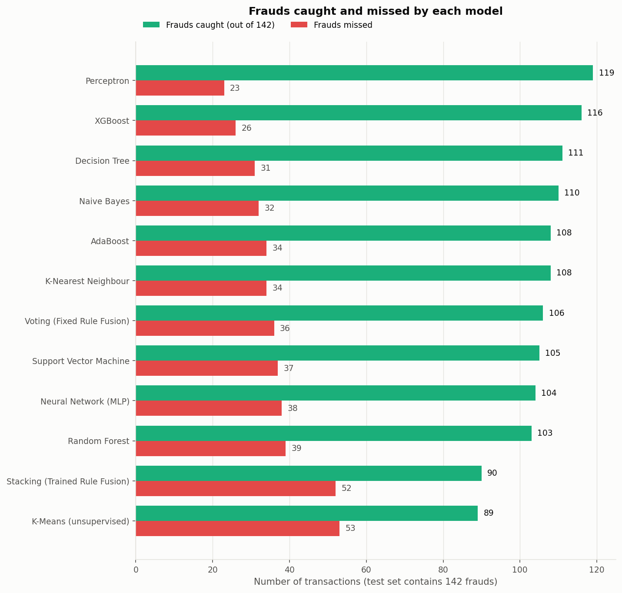
14
Errors in absolute terms
Results
Percentages hide what the numbers mean operationally
XGBoost
116 caught · 6 false alarms
Random Forest
103 caught · only 3 false alarms
Perceptron
119 caught · but 57 false alarms
Notes:
The F1 column hides this trade-off. Random Forest is the most precise; the perceptron catches the most frauds but at a cost.

Slide 18
15
Is the ranking real?
Unit I
5-fold stratified cross validation on the training data
Model | CV F1 (mean) | Std dev | Train time
Random Forest | 0.8319 | 0.0127 | 59.0 s
XGBoost | 0.8293 | 0.0304 | 9.0 s
Decision Tree | 0.8011 | 0.0409 | 22.3 s
Perceptron | 0.5843 | 0.2941 | 1.5 s
Naive Bayes | 0.2381 | 0.0167 | 0.7 s
The cross-validated ranking agrees with the held-out ranking — the result is a property of the models, not of one lucky split
Random Forest's std dev of 0.0127 is exactly the variance reduction bagging is designed to deliver
The perceptron's 0.2941 reflects its instability on a non-separable problem
XGBoost matches Random Forest in one sixth of the training time
Notes:
The standard deviation column is as informative as the mean.

Slide 19
Conclusion
XGBoost performed best — precision 0.9508, recall 0.8169, F1 0.8788. It detects 116 of 142 frauds while raising only 6 false alarms.
Four theoretical results confirmed experimentally
The perceptron convergence theorem — converged on four separable gates, failed on XOR
The curse of dimensionality — k-NN performance declined as attributes were added
The Bayes optimal decision rule — applicable only after calibrating the posteriors
Variance reduction by bagging — visible in Random Forest's low CV standard deviation
Accuracy is unusable at this class imbalance. Model selection must be based on recall, precision, F1 and PR-AUC.
Notes:
If you remember one thing from this presentation, make it the accuracy point.

Slide 20
Thank you
Questions?
Lakshay · AP24110010677 · B.Tech CSE · SRM University – AP
github.com/lakshay8toic/Credit-Card-Fraud-Detection
Notes:
Repository contains all ten notebooks with outputs, 61 figures, the full results tables, and the project report.

